Slide 1
BANK SECURITY SYSTEM BASED ON VOICE RECOGNITION
Submitted by:
Abdul Jabber Antor (1906062)
Tapu Dutta (1906049)
Jonaidul Islam Sikder (1906041)
Md. Rakib Hossain (1906034)

Slide 2
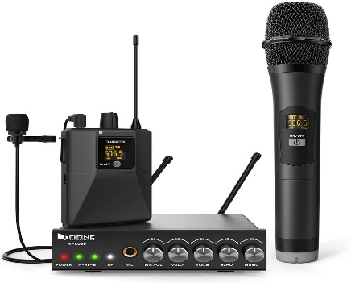

Objective
Developing a user friendly security system for a bank/ATM booth based on voice that will operate in Bangla language.
Components
Microphone Laptop

Slide 3
Data collection:
We collected 118 pairs of voice samples from about 160 classmates and hall residents.
But after trimming we found 82 useful data pair. We had to reduce so many samples because of better accuracy. Firstly, it will be implemented in Bank. So noiseless samples were prioritized. Secondly for our methodology, both id and name voice had to be of same quality and noise.

Slide 4
METHODOLOGY
Speech signal input
Pre processing
Test
Or
Train
Feature extraction
Feature extraction
Test Speech Features
DTW
Database template
Decision logic
Verification

Slide 5
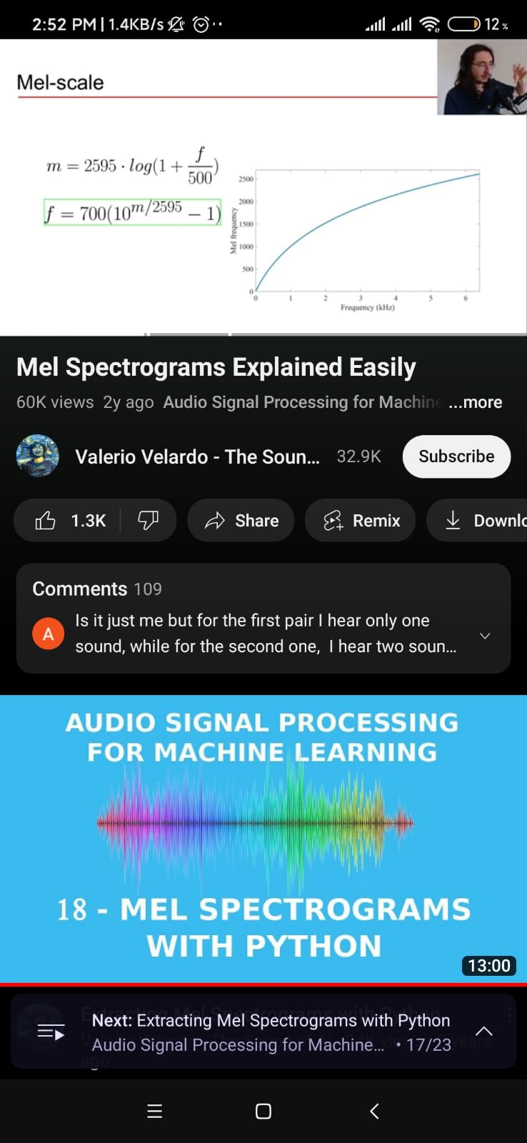
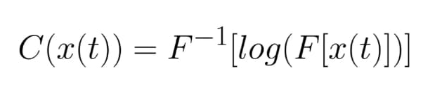
Computing Mel Frequency Cepstral Coefficients
Waveform
DFT
Mel frequency conversion:
Log amplitude Spectrum
Mel scaling
Discrete Cosine Transform
Coefficient value :
MFCCS

Slide 6
DTW: Dynamic Time Warping
The Dynamic Time Warping (DTW) algorithm is a method used to measure the similarity between two time series data in the field of speech recognition. DTW works by aligning two time series data that may have different lengths and different speeds of changes. It finds the best alignment between the two sequences by stretching or compressing one or both of them in time, while minimizing the distance between their corresponding data points. The distance measure used can be any distance metric such as Euclidean distance, Manhattan distance, or any other similarity measurement. where a matrix is constructed to represent the alignment costs between each pair of points in the two time series. The DTW path is then traced back through the matrix to find the best alignment, which gives the minimum distance between the two time series.

Slide 7
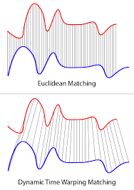
DTW

Slide 8
COST ANALYSIS
Microphone: 3000/=
ANC (Active Noise cancellation) microphone required; hence increased cost.
Microphone Isolation Shield: 5500/=
To avoid echoing of sound
Source: bdstall.com
Glass Booth: 7000/=
Approximately 7’X5’X5’ glass booth required.
(Setup cost included)
Total Cost: 15500/=

Slide 9
POSSIBLE APPLICATIONS
Advantage
Better data security of bank account users
Beneficial for illiterate people
Lessens complications for users and authority
Cost effective setup
Class attendance
Vending Machines
Election Voting
ATM Booth
Conference Hall Entrance
Phone/Laptop unlock
Hospital patients’ database access
Drawbacks
This is not 100% reliable as per the test results
Works less efficiently in different environments
For voices of similar pitch it often makes mistakes

Slide 10
Future Recommendations:
1. Using better algorithms consisting of ML and DL
2. Incorporating biometric information testing additionally
3. Using larger database

Slide 11
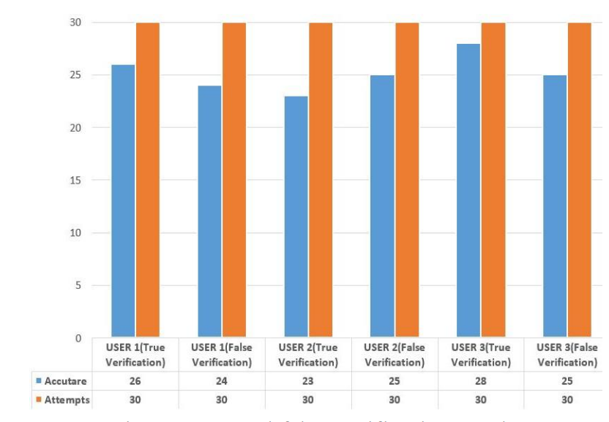
Previous Batch Accuracy :

Slide 12
Our result accuracy:

Slide 13
Implementation (flowchart):
the implementation of a voice detection system in bank security involves a combination of technical setup, training, and ongoing maintenance to ensure that it provides reliable and effective security for the bank and its customers. The steps are:
Bank choosing a reliable system with a high degree of accuracy
Bank personnel collecting voice samples from authorized personnel and giving input them into the voice recognition system for training
The voice detection system being installed on a computer with appropriate hardware and software and configured to work with the bank's security system.

Slide 14
The system being calibrated to accurately recognize voices in the bank's environment. (This involves adjusting microphone sensitivity, setting noise thresholds, and testing the system to ensure accuracy)
The voice detection system being integrated with other security measures, such as security cameras, access control systems, and alarm systems
Bank personnel being trained on how to use the voice detection system, including when and how to activate it
The system being tested thoroughly to ensure that it works as intended, and any issues are addressed
Ongoing maintenance and testing are performed to ensure that the system continues to function properly and provide effective security for the bank

Slide 15
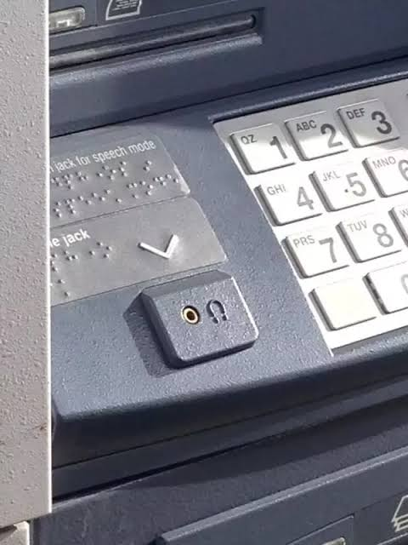
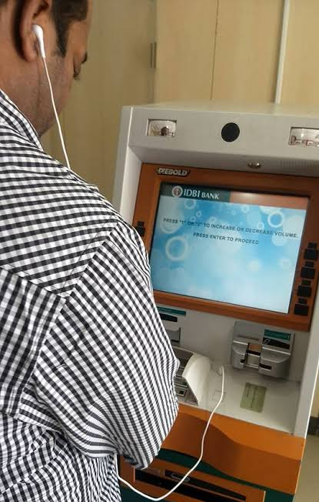
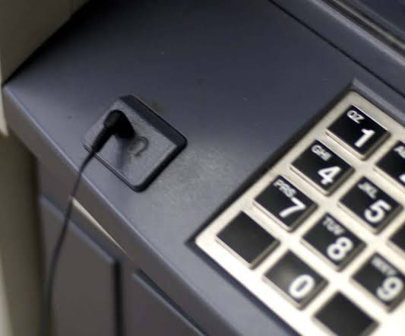
Implementation in ATM booth:

Slide 16
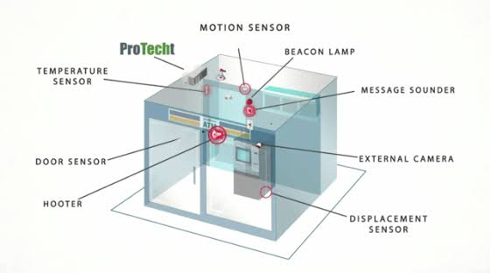
Contd……
Figure : Future developments in ATM booth security system

Slide 17

Future Plans for the project:
Blind people can be helped a lot by voice-based speaker recognition.
Using ATM booths is difficult for them, the way it is.
We aim to develop a system , where blind personnel can access ATM booth only with voice.

Slide 18
THANK YOU!
Any Questions?

